Slide 1
Remote Shell MPI

Slide 2
Hello!
We are group One
Tạ Đức Anh
Trương Sĩ Thi Vũ
Đinh Như Minh Phương
Oketola Praise Oluwabamise
Nguyễn Tuấn Duy

Slide 3
Content
Introduction
Objectives
State of Art
Method
Evaluation
Conclusion
Demo
Q&A

Slide 4
1. Introduction

Slide 5
Introduction
MPI
MPI stands for Message Passing Interface and is a library specification for message-passing, proposed as a standard by a broadly based committee of vendors, implementors, and users.
RSH
RSH stands for Remote Shell, it is a command line computer program that can execute shell commands as another user, and on another computer across a computer network.

Slide 6
2. Objective

Slide 7
Objective
Create a Remote Shell to execute commands through MPI
Learn more about MPI in general
Get 20

Slide 8
3. State of the Art

Slide 9
MPI-Bash - A Parallel version of the Bash shell written by Spakin
Includes various MPI functions for data transfer and synchronization, it is not limited to embarrassingly parallel workloads but can incorporate phased operations (i.e., all workers must finish operation X before any worker is allowed to begin operation Y)

Slide 10
4. Method

Slide 11
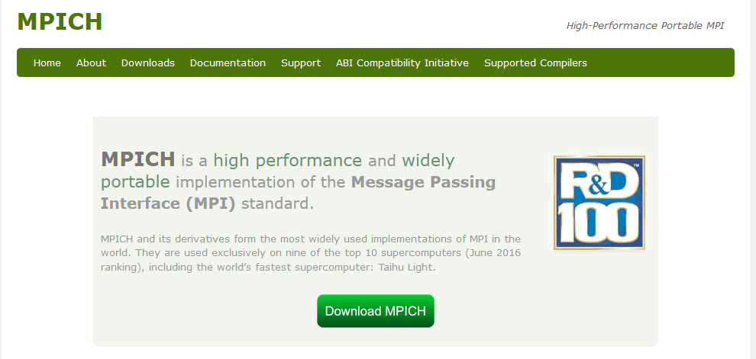
MPI

Slide 12
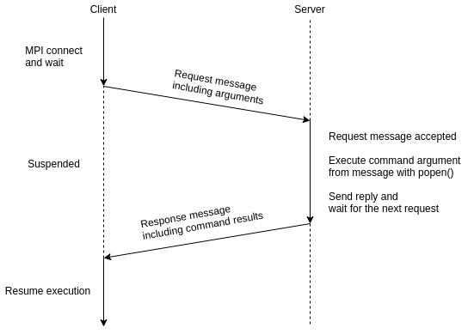
Architecture

Slide 13
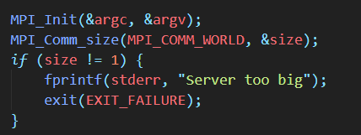
Coding components
Initialize MPI

Slide 14

Coding components
Create port

Slide 15
Coding components
Listen and send

Slide 16
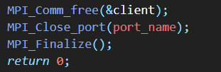
Coding components
Close connections

Slide 17
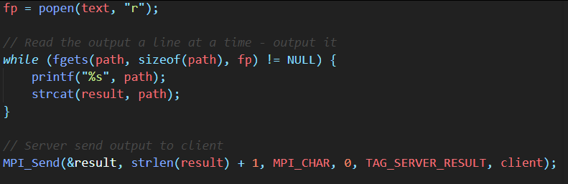
Coding components
Execute commands

Slide 18
5. Evaluation

Slide 19
Handles 1 user / locally

Slide 20
ls : 0.00185 ms
mkdir : 0.001485 ms
df –h : 0.0475 ms
free –m : 0.0352 ms
echo hello bois: 0.00938ms
clear : I didn’t see the response time cause its cleared
reboot: screen is black

Slide 21
6. Conclusion

Slide 22
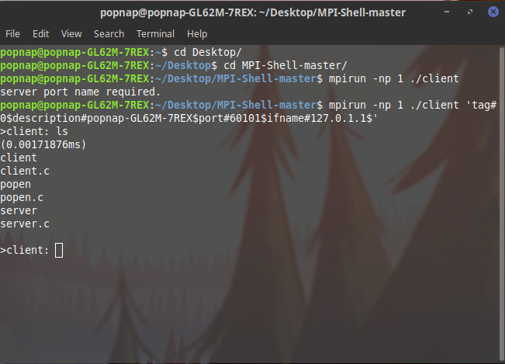

Slide 23
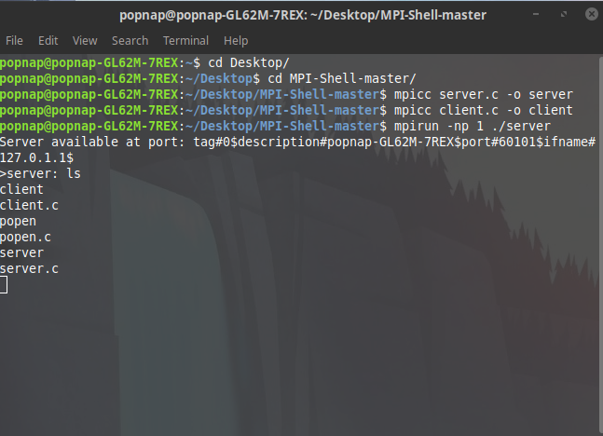

Slide 24
Achieved the goal
Did not take full use of MPI
Took short cuts using popen(), execvp(), system(),…

Slide 25
7. Demo

Slide 26
8. Questions & Answers

Slide 27
The end
Thanks for listening

